Slide 1
Welcome! Database Development and Design
Developing and Design of databases using SQL Server

Slide 2
Agenda
Session 1
Session 2
Session 3
Session 4
Homework discussion
Built-In functions
Workshop
Scalar functions
Workshop
Table valued functions
Inline table-valued function
Multi-statement table-valued functions
Workshop
Knowledge check (Quiz, Discussion, Homework)
Session 5

Slide 3
Agenda
Session 1
Session 2
Session 3
Session 4
Session 5
Homework discussion
Stored procedures
Workshop
Error handling
Workshop
Knowledge check (Quiz, Discussion, Homework)
Summary

Slide 4
Homework discussion

Slide 5
Built-In functions

Slide 6
What are Built-In Functions?
In SQL a built-in function is a piece for programming that takes zero or more inputs and returns a value
Built-In functions are used in SQL SELECT expressions to calculate values and manipulate data. These functions can be used anywhere expressions are allowed.
There are several things to note regarding functions.
The inputs to a function are called parameters. Not all function have parameters, and some functions have more than one.
Parameters are enclosed in parenthesis.
We use functions in the SELECT clause as well as WHERE filter condition. A function can be used anywhere in a SELECT statement that you can use an expression.
Function are reserved words. I would avoid using them as column or table names. If you do, then expect to qualify your names with brackets [].

Slide 7
Built-In functions – Declarations (1/3)
Scalar variable
A scalar variable stores a value with no internal components. The value can change.
A scalar variable declaration specifies the name and data type of the variable and allocates storage for it.
DECLARE @EmployeeId INT
SET @EmployeeId = 1
SELECT * FROM EMPLOYEE WHERE ID= @EmployeeId

Slide 8
Built-In functions – Declarations (2/3)
Table variable - A table variable is declared using the table data type. A statement declaring a table variable initializes the variable as an empty table with a specified structure. As a table definition, such a statement includes definitions of columns with their data type, size, precision, and optional constraints (primary key, identity, unique, and check constraints). All elements have to be defined during the declaration. It is not possible to alter or add them later.
DECLARE @EmployeeList TABLE
(EmployeeId int, FirstName NVARCHAR(100), LastName NVARCHAR(100));
INSERT INTO @EmployeeList
SELECT Id, FirstName, LastName from dbo.Employee

Slide 9
Built-In functions – Declarations (3/3)
Temp table - database table that exists temporarily on the database server. A temporary table stores a subset of data from a normal table for a certain period of time.
CREATE TABLE #EmployeeList
(EmployeeId int, FirstName NVARCHAR(100), LastName NVARCHAR(100));
INSERT INTO #EmployeeList
SELECT Id, FirstName, LastName from dbo.Employee
At the end, the table must be dropped
DROP TABLE #EmployeeList

Slide 10
Built-In functions – String functions
LEFT(), RIGHT(), LEN()
SUBSTRING
SUBSTRING ( expression ,start , length )
REPLACE
REPLACE ( string_expression , string_pattern , string_replacement )
Example:
select FirstName,
LEFT(FirstName,3) as LeftFunction,
RIGHT(FirstName,3) as RightFunction,
LEN(FirstName) as LenFunction,
SUBSTRING(FirstName,1,3) as SubstringFunction,
REPLACE(FirstName,'Ale','X-') as ReplaceFunction
from dbo.Employee

Slide 11
Additional Built-In functions – useful to know
GETDATE()- The GETDATE() function returns the current database system date and time, in a 'YYYY-MM-DD hh:mm:ss.mmm' format.
ISNULL(expression, replacement) The SQL Server ISNULL() function replaces NULL with a specified value.
NULLIF ( expression , expression ) NULLIF returns the first expression if the two expressions are not equal. If the expressions are equal, NULLIF returns a null value of the type of the first expression.
CONCAT (adds two or more strings together)
CAST And CONVERT (convert an expression of one data type to another)

Slide 12
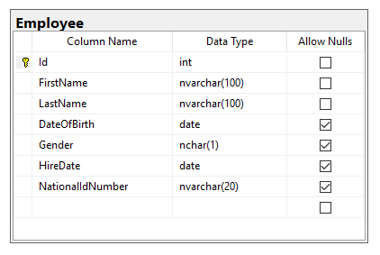
Built-in functions - Workshop
Declare scalar variable for storing FirstName values
Assign value ‘Aleksandar’ to the FirstName variable
Find all Employees having FirstName same as the variable
Declare table variable that will contain EmployeeId and DateOfBirth
Fill the table variable with all Female employees
Declare temp table that will contain LastName and HireDate columns
Fill the temp table with all Male employees having First Name starting with ‘A’
Retrieve the employees from the table which last name is with 7 characters

Slide 13
Scalar functions

Slide 14
User defined Functions in T-SQL
T-SQL has plenty of in-built functions so that if we know how to use them we don’t even need creating our own functions
HOWEVER, there is sometimes a real need of creating our own functions
For example we need to create a function that will be giving to us the number of Orders for a chosen BusinessEntity
Functions must RETURN a value or a set.
Scalar-valued functions
Table-valued functions
Functions have input parameters only; the parameters are always defined in parenthesis ().
Must use dbo (or another schema) to call the function
You can SELECT the functions

Slide 15
Scalar functions
A scalar user-defined function accepts parameters, applies calculations, and returns a single value. It has a body with flow that can have multiple statements, including queries, and eventually it must invoke a RETURN clause to return the result value. The header of the function defines the input parameters as well as the return type using a RETURNS clause.
Scalar functions allow modular programming
Scalar user-defined functions (UDFs) accept parameters and return a single value. You cannot change data from UDFs or have any side effects on the database. T-SQL does not support error handling in UDFs.
How to create:
CREATE FUNCTION FunctionName (@ParaleterList [datatype])
RETURNS [datatype]
AS
BEGIN
DECLARE @OutputVariable [datatype]
SELECT @OutputVariable = ...
RETURN @OutputVariable
END
Notes:
https://docs.microsoft.com/en-us/sql/relational-databases/user-defined-functions/user-defined-functions?view=sql-server-2017

Slide 16
Scalar functions - example
Session 4 – 01 Scalar function.sql
Example for scalar function:
CREATE FUNCTION dbo.fn_EmployeeFullName (@EmployeeID int)
RETURNS NVARCHAR(2000)
AS
BEGIN
DECLARE @Result NVARCHAR(2000)
SELECT @Result = e.FirstName + N' ' + e.LastName
FROM dbo.Employee e
WHERE Id = @EmployeeID
RETURN @Result
END
How to call:
select dbo.fn_EmployeeFullName(1)
Notes:
https://docs.microsoft.com/en-us/sql/relational-databases/user-defined-functions/user-defined-functions?view=sql-server-2017

Slide 17
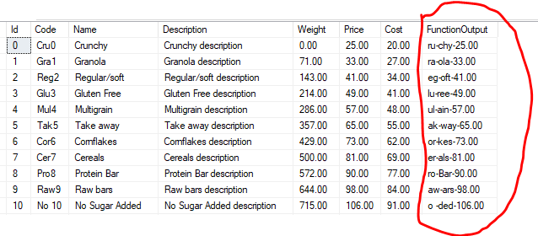
Scalar functions - Workshop
Declare scalar function (fn_FormatProductName) for retrieving the Product description for specific ProductId in the following format:
Second and Third character from the Code
-
Last three characters from the Name
-
Product Price

Slide 18
Table-valued functions
Multi-statement

Slide 19
Table-valued functions
allow modular programming
Allows multiple input parameters
return table on output
Notes:
https://docs.microsoft.com/en-us/sql/relational-databases/user-defined-functions/user-defined-functions?view=sql-server-2017

Slide 20
Table-valued functions
Multi-statement table-valued function
Allows multiple SQL Statements in the function body
How to define:
Example:
Session 4 – 03 Multi-statement TVF.sql
CREATE FUNCTION FunctionName (@ParameterList [datatype])
RETURNS @TableVariable table (Column1, Column2,...)
AS
BEGIN
INSERT INTO @TableVariable
SELECT Column1,Column2,...
FROM TABLE1
RETURN
END
Notes:
https://docs.microsoft.com/en-us/sql/relational-databases/user-defined-functions/user-defined-functions?view=sql-server-2017

Slide 21
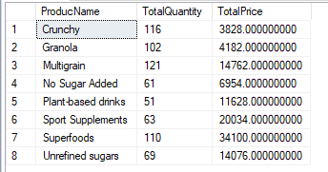
Functions - Workshop
Create multi-statement table value function that for specific BusinessEntity and Customer will return list of products sold, together with the total quantity sold and total price per product
Example resultset:

Slide 22
Knowledge check
Quiz, Discussion, Homework

Slide 23
Quiz
Can we assign multiple values to scalar variable?
a. Yes
b. No
Which SQL function is used to determine number of characters in the string?
a. LEFT
b. STRING
c. STRING_SIZE
d. LEN
Can we return single value in table-valued function
a. Yes
b. No

Slide 24
Quiz
Can we return two records in scalar function?
a. Yes
b. No
Can we insert data in some table by using table valued function?
a. Yes
b. No
Can we insert data in some table by using scalar function?
a. Yes
b. No

Slide 25
Quiz
What is the main difference between temp table and table variable?

Slide 26
Homework

Slide 27
Homework requirement 1/3
Declare scalar variable for storing FirstName values
Assign value ‘Antonio’ to the FirstName variable
Find all Students having FirstName same as the variable
Declare table variable that will contain StudentId, StudentName and DateOfBirth
Fill the table variable with all Female students
Declare temp table that will contain LastName and EnrolledDate columns
Fill the temp table with all Male students having First Name starting with ‘A’
Retrieve the students from the table which last name is with 7 characters
Find all teachers whose FirstName length is less than 5 and
the first 3 characters of their FirstName and LastName are the same

Slide 28
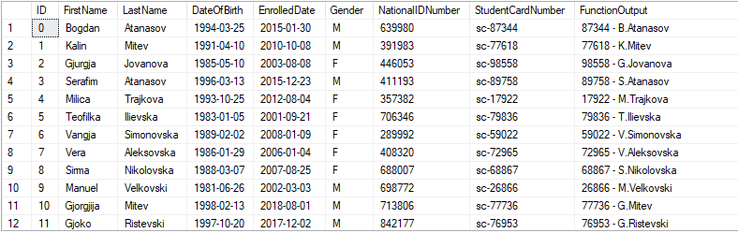
Homework requirement 2/3
Declare scalar function (fn_FormatStudentName) for retrieving the Student description for specific StudentId in the following format:
StudentCardNumber without “sc-”
“ – “
First character of student FirstName
“.”
Student LastName

Slide 29
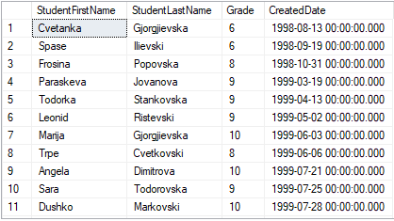
Homework requirement 3/3
Create multi-statement table value function that for specific Teacher and Course will return list of students (FirstName, LastName) who passed the exam, together with Grade and CreatedDate
Example resultset:

